Slide 1


pOTATO LEAF DISEASE DETECTION

Slide 2

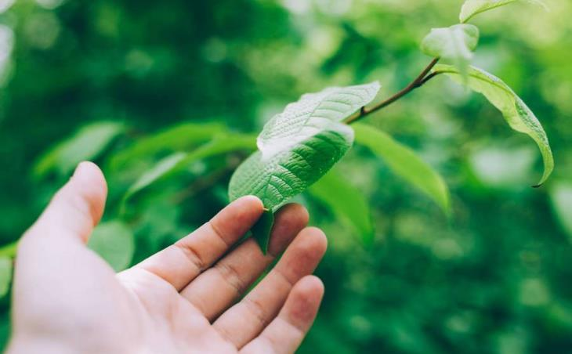
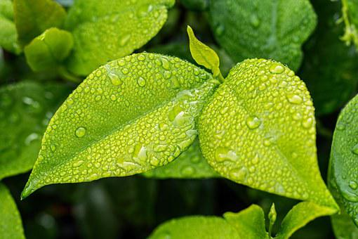
INDEX
INTRODUCTION
PROBLEM STATEMENT
PROPOSED APPROACH
DATA SET
PREPROCESSING
VISUALIZATION
IMPLEMENTATION SAMPLE
CONCLUSION

Slide 3
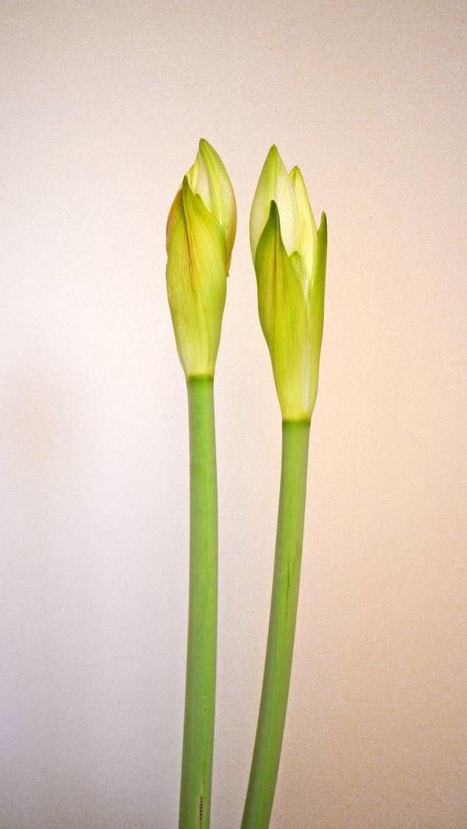
Introduction
We will develop an end to end project which is based on pure deep learning. The reason behind building this project is to detect or identify potato leaf diseases, having a variety of illness. With our naked eyes we can’t classify them, but Convolutional Neural Network can do easily. You can’t believe when I tell you the error of some pre-trained Neural Network Architectures because it is approximately 3%, which is even less than the top 5% error of human vision. On the large-scale images, the human top-5 error has been reported to be as 5.1%, which is higher than pre-trained networks.

Slide 4
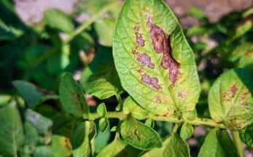
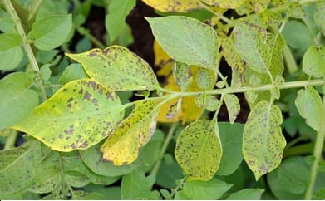
PROBLEM STATEMENT
It is a potato leaf disease detection system used to detect the disease in the potato leaves.

Slide 5
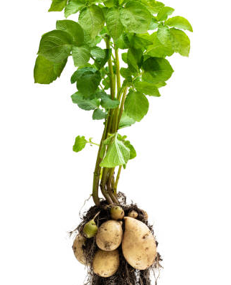
DATA SET
The dataset is organized into 3 folders (train, test, val) and contains subfolders for each image category (Pneumonia/Normal). There are 4025 X-Ray images (JPEG) and 3 categories (late bright/healthy bright/early bright).
For the analysis of leaf detection images, all images are radiographs, were initially screened for quality control by removing all low quality or unreadable scans.
There are 3254 training images and 408 testing images.
There are 419 validation images.

Slide 6
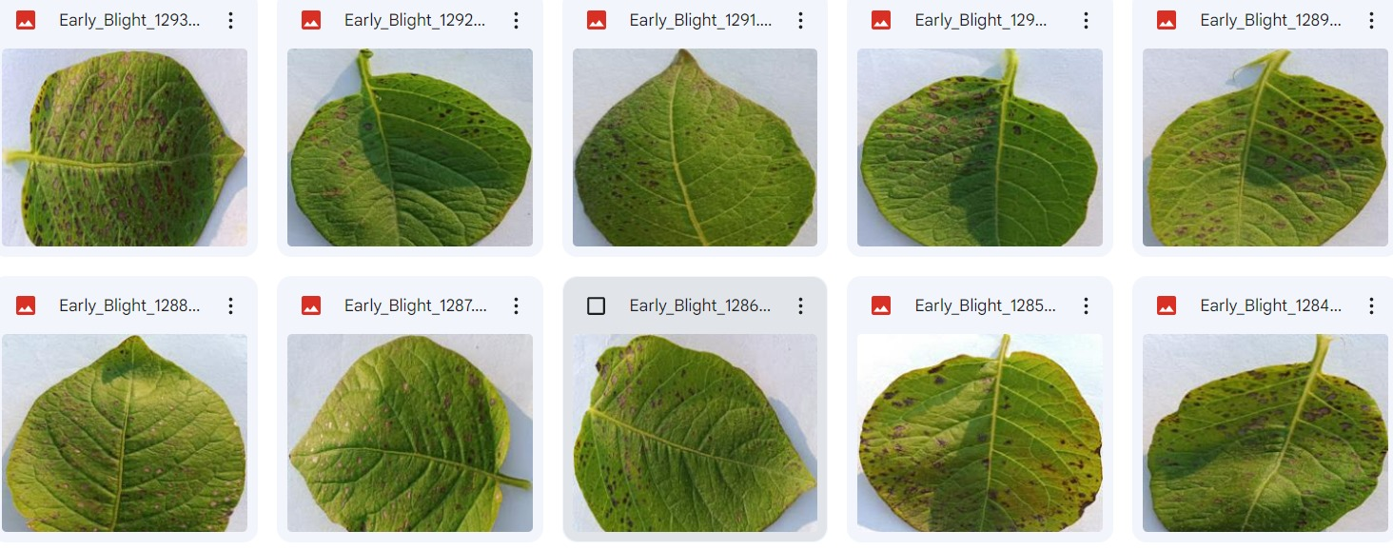
TRAINING IMAGES

Slide 7
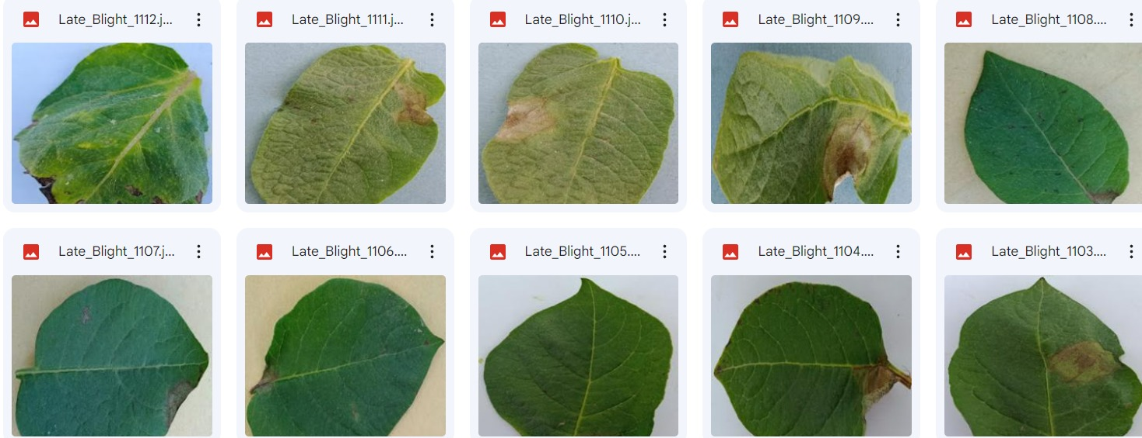
TESTING IMAGES

Slide 8
PRE-PROCESSING
Data Pre-processing is a technique that is used to convert the raw data into a clean data set.
Collecting the required images from hospitals and available resources.
To read the images we use open-cv library which is available in python.
Open-cv is used for image processing and image maniplulation.
we use numpy library and open cv library to convert images to matrix.
We can use list and array function to convert images to matrix.

Slide 9
IMPLEMENTATION SAMPLE
In this we used 5 algorithms to detect the disease in the potato leaf..
Logistic regression
Decision tree
Support vector machine(SVM)
K-nearset neighbours
Random Forest

Slide 10
ALGORITHMS OR MODELS | ACCURACY
Logistic regression | 0.6296296296296297
Decision tree | 0.6246913580246913
Support vector machine(SVM) | 0.7555555555555555
K-nearset neighbours | 0.6246913580246913
Random Forest | 0.7975308641975308
From the above table we can say that for our project the random forest algorithm is giving the accurate value. So, the random forest algorithm is the accurate approach to detect the disease in the potato leaf.

Slide 11
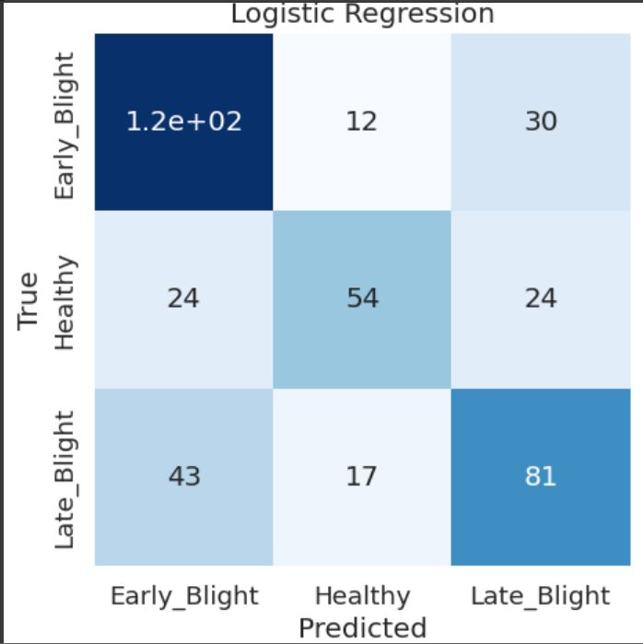
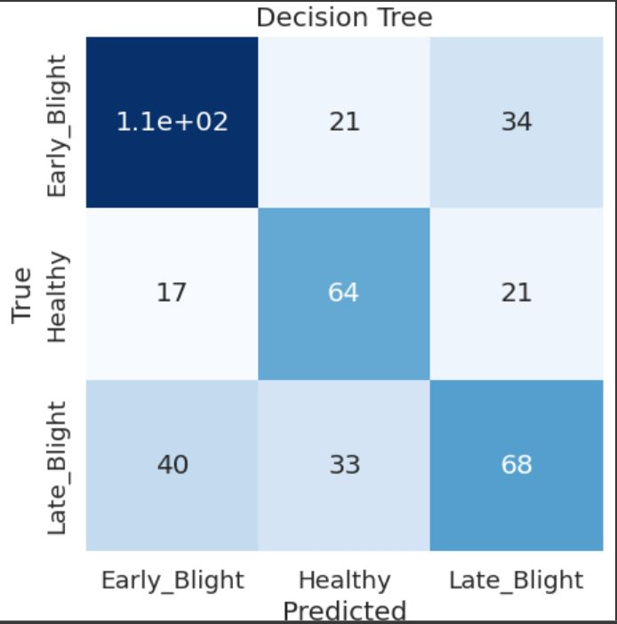
VISUALISATION
LOGISTIC REGRESSION DECISION TREE

Slide 12
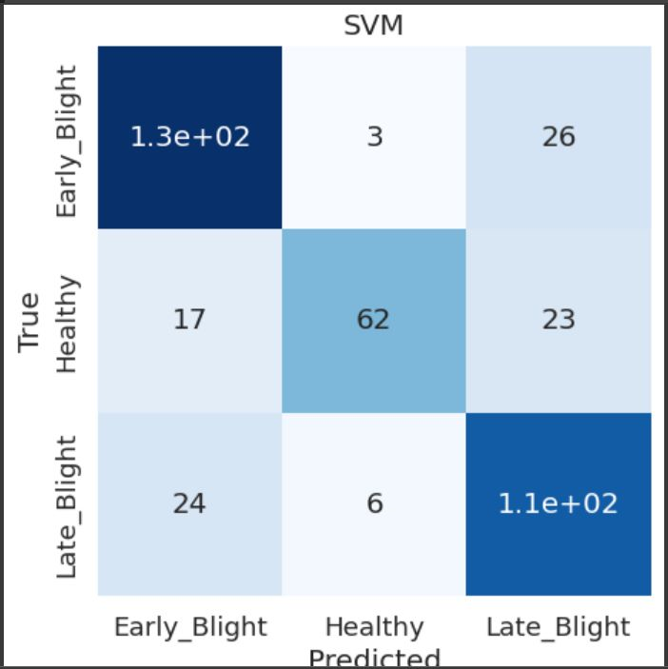
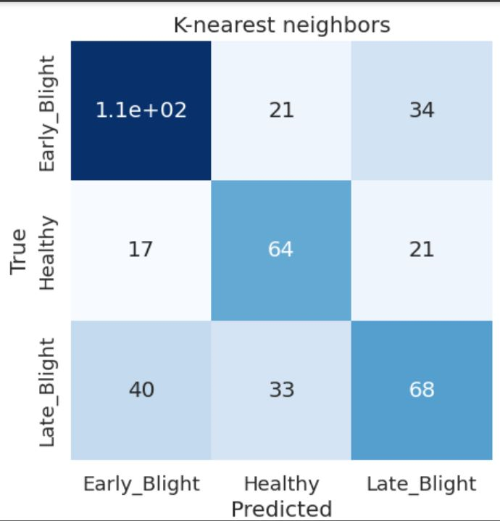
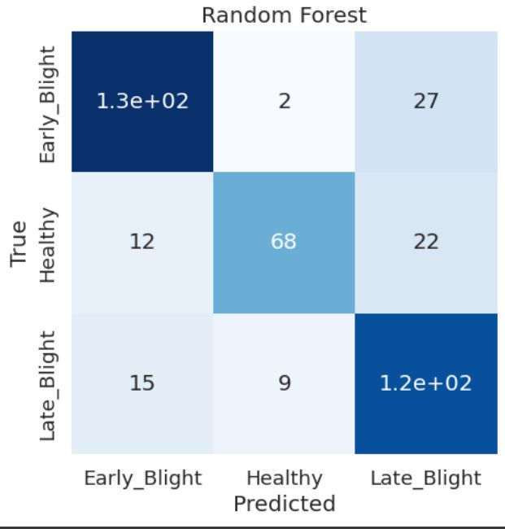
SVM K-NEAREST NEIGHBORS
RANDOM FOREST

Slide 13
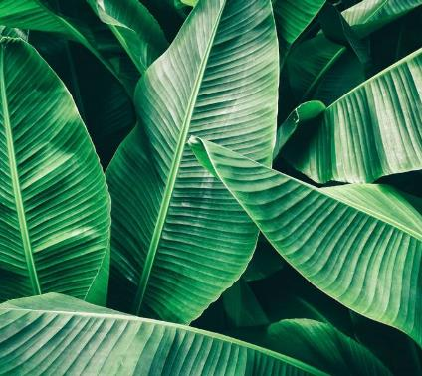
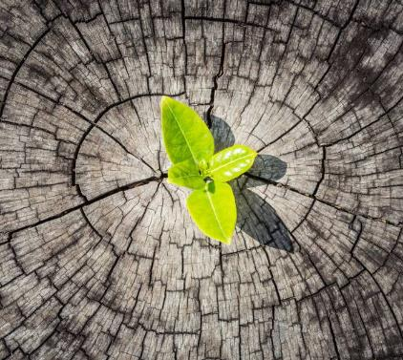
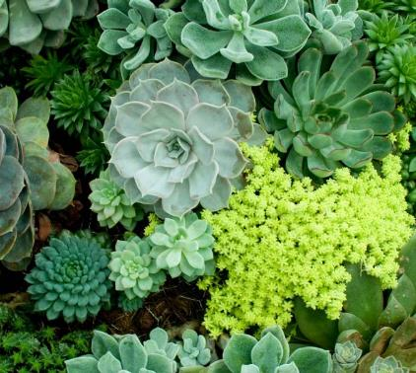
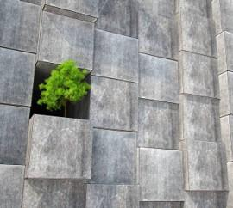
Conclusion
This project is a remarkable illustration of how AI and ML can address practical issues for the given current situation.
Several diseases in potato plants can be identified based on leaf conditions.
By this project we can get high rate of accuracy so that it can bring many benefits to agriculture related to world food security.

Slide 14
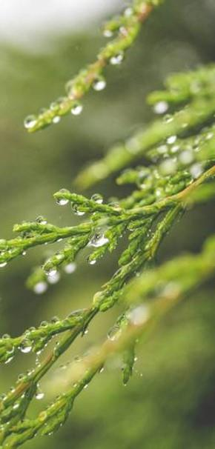
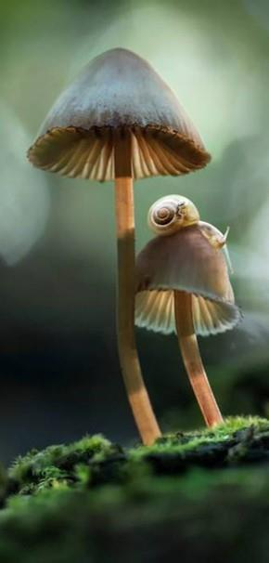
Thank you

